Slide 1
Conceptual Design Overview & Key Findings
Anexinet ISG Delivery Team

Slide 2


AGENDA
Microsoft/Exchange/SQL
Citrix/EUC
Physical Network
Core Redesign Overview
vSphere Upgrade/C7000 Redesign
vSphere Cluster Consolidation
vSphere Licensing
P2V
Storage
vSphere Networking Design
Backup
Disaster Recovery
February Test Overview
Next Steps

Slide 3
Key Findings

Slide 4


Microsoft/Exchange/SQL
Windows 2003 Server Upgrades (End-of-Life)
AD Upgrade & Cleanup Initiative
AD Forest and Domain Functionality from 2003 to Current
Stale Group and User Cleanup
i.e.: 4100 Groups in AD
Decommission 2003 Domain Controllers
Pre-requisite: RightFax Upgrade (In Progress)
Exchange 2003/2007 Upgrade
Pre-requisite: RightFax Upgrade (In Progress)
Implement Redundancy/Resiliency Measures
SQL Migration and Consolidation
Pre-requisite: Data Warehouse Architect (In Progress)
Full Design Deliverable (In Progress)

Slide 5
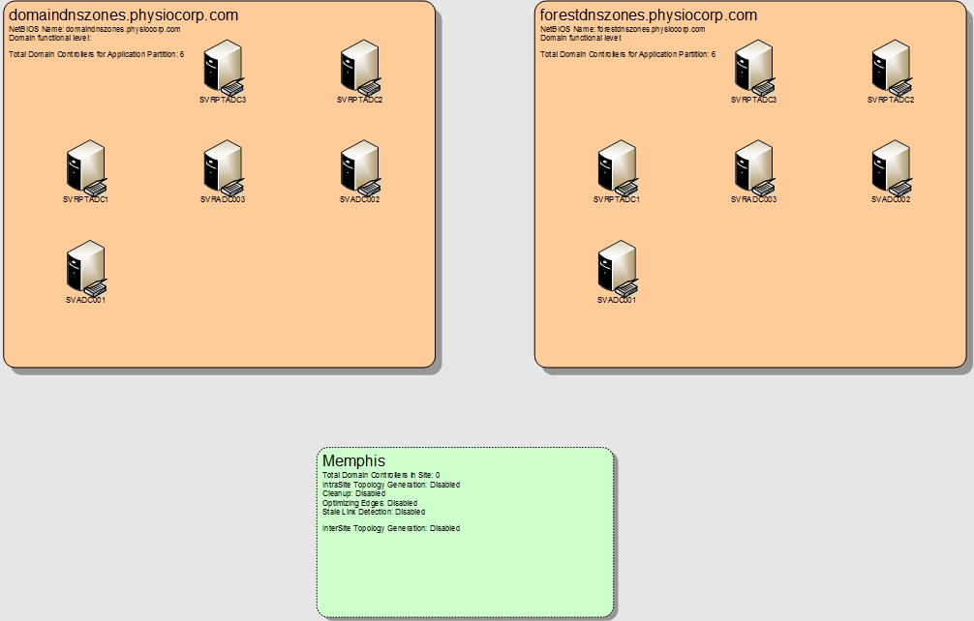
Microsoft Forest Overview

Slide 6

Citrix
Citrix Hotfix/Version Inconsistencies (4.5, 6.5, & 5.6 Environments)
Citrix Environment Consolidation to Version 7.6 of XenDesktop
Implement Citrix Leading Practices Throughout
NetScaler Configuration and Optimizations
Monitoring Design Initiative (part of full detailed design)
eG Innovations Overview
Single Image Management via Provisioning Services
XenApp and XenDesktop Groups
More Centralized Management of Data
Server and Storage Optimizations
PernixData Overview (Next Steps)
Endpoint Device Recap Potential
Update Thin Clients in the Field – Windows Embedded
Onboarding and User Pilot Testing for Eventual New Environment Build
150-200 Users/Week

Slide 7
Recommended Citrix/App Delivery Model
Application Assessment Method/Approach
Phased application assessment
Base image 1
XenApp Published Applications
Base image 2
XenApp Hosted Shared Desktop
Base image 3
XenClient (Optional)
Base image 4
XenDesktop Pooled Desktops
Base image 5
PCs managed by SCCM

Slide 8

Physical Network
Replace 5020s, 6509s, C2960s, and FWs
Cisco Nexus – VPC technology
Cisco ASA 55X5 Series with Firepower capabilities
Cisco ISR series routers
Preserve overall Layer2 design
Possible additions
Possible use of WAN compression
Will wait to see the impact of vSphere Replication on WAN and FW
WAN uses:
vSphere Replication
Exchange DAG replication
SQL DAG replication?
Physiotherapy remote facilities (core business)
Backup replication

Slide 10
Core Redesign overview
Upgrade three c7000 chassis’
Unlink c7000 chassis
Consolidate vSphere hosts to blades
Standardize all vSphere to 5.5 U2
Standardize all SAN to VNX 7500 via FC

Slide 11
vSphere Upgrade/c7000 Redesign
Upgrade 24 Cluster1 vSphere hosts to 5.5
Install/configure HP OneView
New c7000 design:
Latest HP firmware
Use non-stacked networking
Connect to new external FC switches
Connect to DMZ VLAN
Add 8 new vSphere 5.5 hosts to Cluster1
Migrate VMs to new c7000 and upgrade existing chassis’
Redistribute VMs amongst c7000 chassis’
Upgrade VM tools and vHW

Slide 12
Vsphere Cluster Consolidation
Add DMZ VLAN to Cluster1 hosts
Migrate all Cluster3/DMZ VMs (23) to Cluster1
Reuse DMZ host in Management Cluster (Cluster2)
Migrate Cluster2 SAN type to FC
Upgrade Cluster2 to vSphere 5.5

Slide 13
Vsphere Licensing
Upgrade vSphere licensing to 5.5 Enterprise Plus
Will require purchasing vSphere 5 Enterprise licensing to Enterprise Plus
Will provide licensing for 32 current blades + 3 DL360s, with headroom for 14 additional hosts

Slide 14
P2v
Benefits of P2V:
Reduces dedicated LUNs that can be added to vSphere pools and shared among all vSphere hosts
VMs can be replicated to Hosting.com DR site
Reduction of footprint at SunGard and Hosting.com
Consolidation of resources to three c7000 chassis’
Reduced support costs as rack servers are retired
Goal: P2V as many physical servers as possible
Virtualizing physical servers frees up Rackspace at SunGard and enables DR via SRM to Hosting.com
Note P2V exceptions like:
Exchange
NextGenDB
Extremely large memory servers
List Required capacity for new VMs
Table showing before and after P2V

Slide 15
Storage
Will Exchange Storage stay SAN based?
EMC Disk Pools:
Current have 3 vSphere pools: High, Mid, Low
Looking at possibility of moving to 2 pools(Gold / Bronze)
P2V’s will free up LUNs that can be recreated and added to vSphere pools
Space will be recovered from the P2V process. Used LUNs will be returned to the same disk pool.
2TB LUNs with Datastore Clusters aligned with Storage pools
Have a couple of large VMDKs (1.7 TB). Considering changing to 3TB LUNs to reduce LUNs as well as increase size for large VMDKs
Powerpath is installed on most physical servers with various versions
Either unlicensed of licensed for Powerpath migration enabler

Slide 16
vSphere Networking Cluster1 Blades
Any changes to VLANs?
OA is on 172.26.15.0/24

Slide 17
Backup
Current issues:
VADP backups failing and leaving VM snapshots behind
Backup of DB VMs are failing to quiesce
No offsite archiving solution
License capacity calculation issue: will be fixed with Service Pack 11
Commvault Simpana
Simpana physical server with FC HBA (add)
VADP based backups from physical Simpana server(s)
Backup destination: 3PAR via FC (currently iSCSI)
Used to leverage HP StorServer NAS servers as a backup measure
Notes:
44 existing blades
2 of which are older AMD CPU

Slide 18
Backup
Possibly could use Commvault to replicate backup jobs to HP ServStore servers at Hosting.com?
Recommend leveraging 3PAR at HOSTING.COM
Replicate backup data with 3PAR’s remote copy technology
Metadata will be replicated with SQL mirroring to a physical Commvault server at HOSTING.COM
Same server will be used for replicating the NAS data
Notes:
44 existing blades
2 of which are older AMD CPU

Slide 19
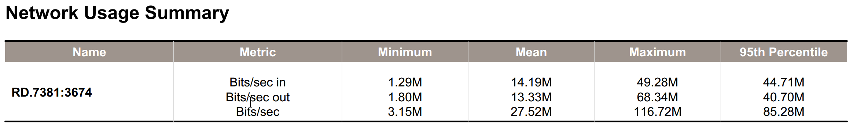
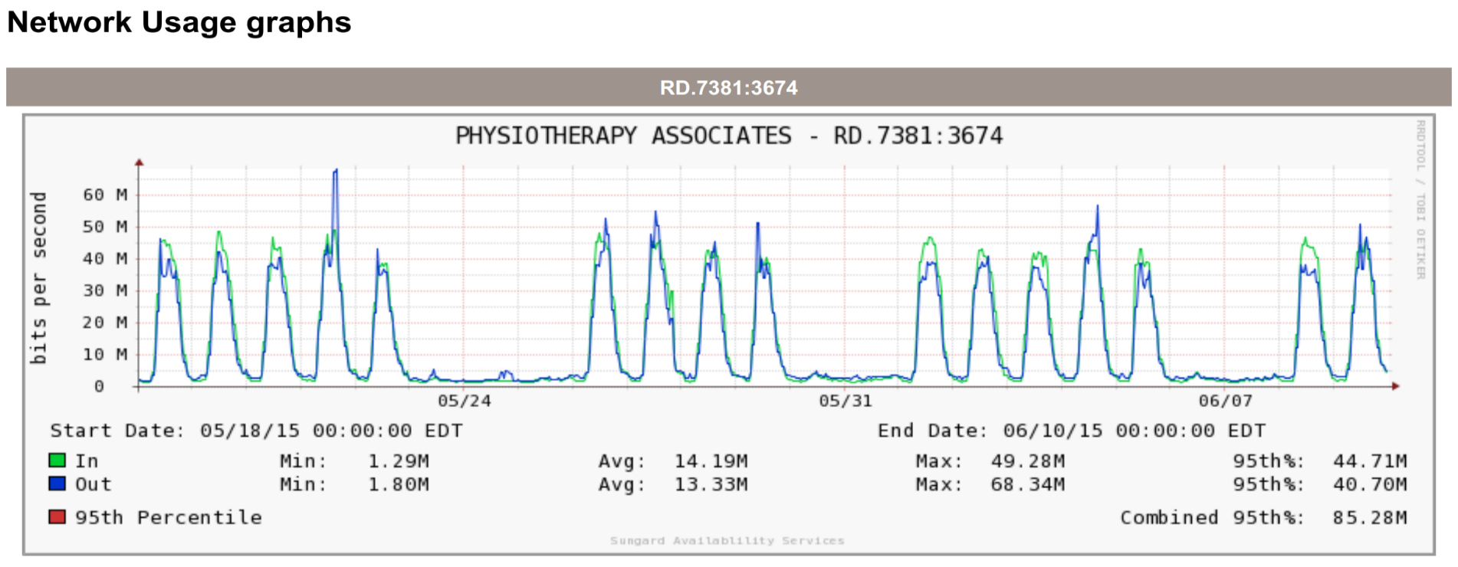
Disaster Recovery - WAN
SunGard WAN summary 5/18-6/10
Peak usage – 116Mbps of current 250Mbps
Notes:
44 existing blades
2 of which are older AMD CPU

Slide 20
Disaster Recovery - VMs
vSphere Replication 5.8 (no special LUN grouping required)
SAN replication is not in scope
vSphere Site Recovery Manager 5.8 (fully managed by Hosting.com)
WAN: Currently 250Mb (can burst higher)
WAN: Current FWs are maxing out on CPU
VMs to be replicated:
Approximately 300
DR Hosting contract estimated based on 300 VMs in Cluster1
Notes:
44 existing blades
2 of which are older AMD CPU

Slide 21
Disaster Recovery-Physical Servers
SQL – Will native SQL replication be configured?
Need to identify all physical servers (post P2V) that need to be replicated
There are contractual limitations at Hosting.com on physical servers
Physical servers freed by P2V could be moved to Hosting.com as standby hosts for physical server recovery
Physical servers that have built-in replication (like Exchange) could be replicated from physical (protected site) to VM (recovery)
Physical appliances? (Barracuda, Mail archive, etc.?)
Are there virtual instances that can be run in DR site?
How long can Physio VMs run in DR failover mode?
Notes:
44 existing blades
2 of which are older AMD CPU

Slide 22
Next Steps

Slide 23
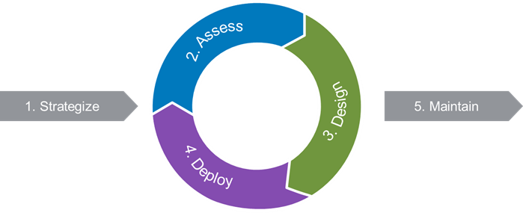
Next Steps
Short Term
Full Detailed Design Completion (In Progress)
Delivery date – June 26th (Every practice area – posted to Teamwork)
Client Design Review – Physiotherapy
Phased Approach List for Implementation - Anexinet
Continue Migration Efforts and Testing
Implement Initial Configuration
Long Term
Finalize Implementation and Remediation Effort
DR Environment and Considerations

Slide 24
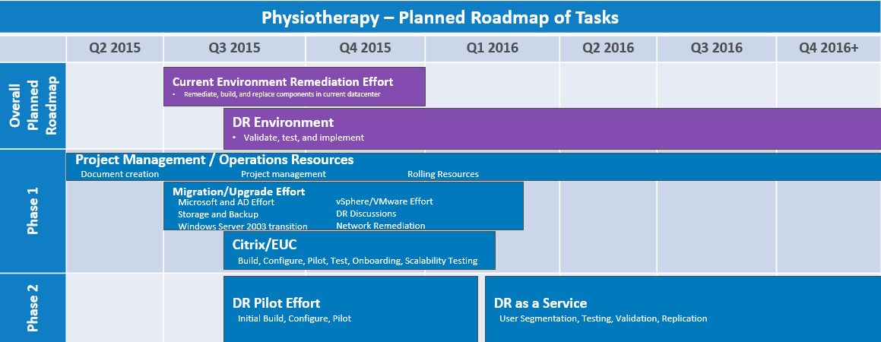
Planned Implementation Roadmap

Slide 25
Next Steps/Microsoft Residency Work Stream
Issue | Priority | Notes | Workstream | Complete
RightFax Upgrade | High | RightFax upgrade is required to decommission the Exchange 2003 servers from the Org. It also utilizes the Windows 2003 Domain Controllers | MS Residency | Needed prior to AD work
Active Directory NTP Time | Med | NTP is not configured correctly in the Domain Controllers | MS Residency
Empty Group Clean up | Low | Approximately 4,100 Empty Groups in AD | MS Residency
DC Operating System Patches | Med | DCs are missing Patches or nto configured to receive patches from MS Update | MS Residency
Exchange Service Packs | High | Legacy Exchange servers are not at the required service pack level for co-existence with Exchange 2013 | MS Residency
AD Account Cleanup | Low | Review and remediate AD User and Computer accounts | MS Residency
Licensing Server Installation | High | Install and Configure KMS Server for the Domain | MS Residency
MS Assesment and Planning Toolkit | High | Install and Configure MAP Toolkit for Licensing assessments and reports | MS Residency
Service Account Review | Med | Review Service Accounts used on all windows servers. Convert to Group Managed Service Accounts | MS Residency
Scheduled Tasks Review | Med | Scheduled Tasks are scattered about on servers with little to no documentation. Document all AT tasks and convert to gMSA where applicable. Review Possible Consilidation and task relocation. | MS Residency
Server Rights Review | Low | Review Local User Rights on all Windows servers. Implement Role Based access where applicable. | MS Residency
Application Review | Med | Document all Server based aaplication in the PhysioCorp domain. Identify all apps/app owners/business units and document any/all support contracts | MS Residency
Shavlik Review | Med | Review current Shavlik installation for possibility of leveraging system to patch non-domain joined computers at remote sites | MS Residency
Server Update Process | Med | Develop and Document Patching automatic patching process for all Servers | MS Residency
Solar Winds Monitoring Review | Low | Review monitoring of servers and application by Solar Winds | MS Residency
Laptop Images for Remote Sites | Med | Work with Physio staff to augment laptop image configuration and deployment. | MS Residency
AD Rights and Delegation | Low | Develop Strategy for Role Based Access for AD Administrative rights | MS Residency

Slide 26
Questions?

